Slide 1
SPOMS
Final Product

Slide 2
Topics
Results Achieved
Development Process
Possible Improvements
Self-Assessment

Slide 3
Results Achieved

Slide 4
Results
Final Product:
Every User Story was implemented.
Every client’s requirement was implemented
The product follows a ‘TurnKey’ format
Technical Team:
Communication Improved
Code Quality enhanced
Technical Experience augmented
Planning method revised

Slide 5
Critical Analysis
Strengths:
Individual capabilities
Independence
Medium to High standards
Weaknesses:
Poor communications
Time Management
Follow defined rules

Slide 6
Critical Analysis
Opportunities:
Good communication within teams
Good working environment
Excellent documentation provided
Threats:
Client’s sudden changes
Lack of acknowledgment
Different opinions provided by the technical team (teachers)

Slide 7
Development Process

Slide 8
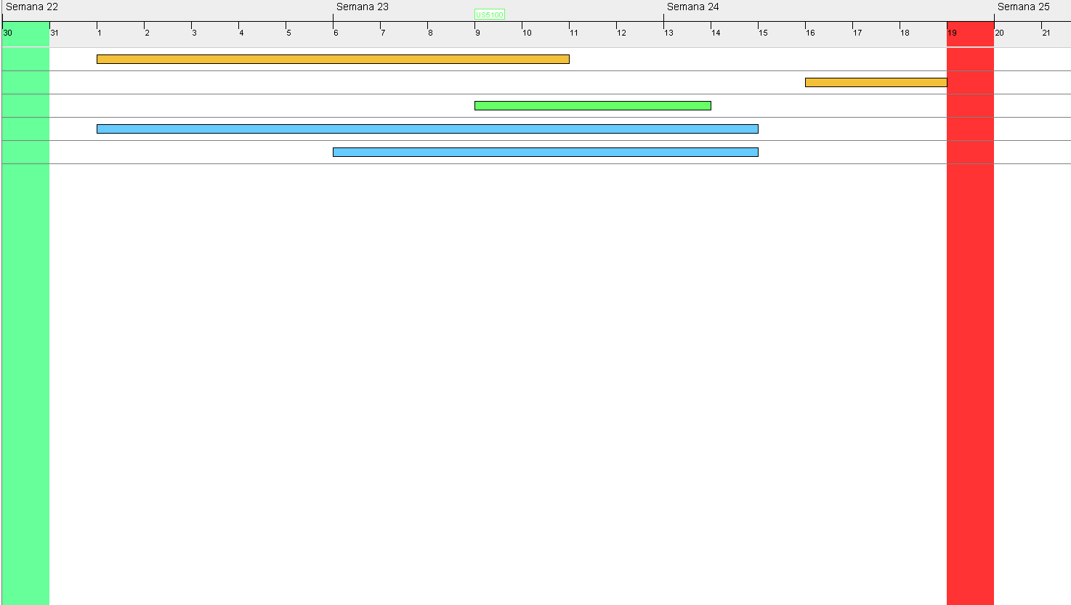
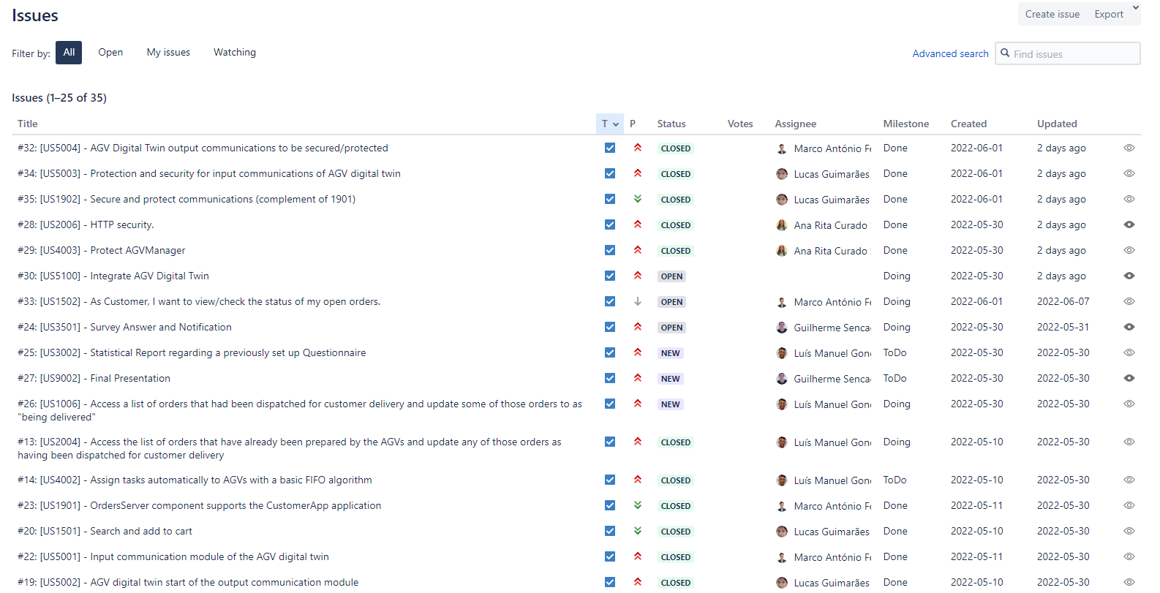
Planning
s
Gantt Project
Bitbucket Issues

Slide 9
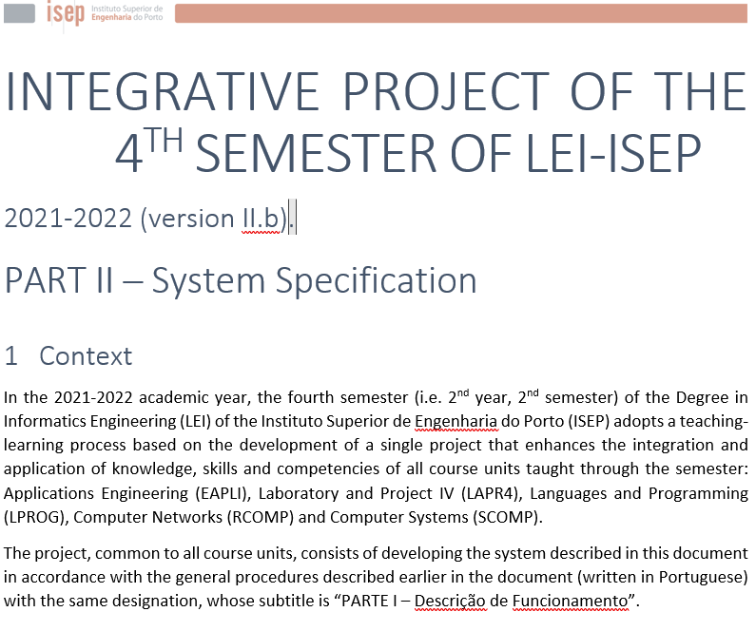
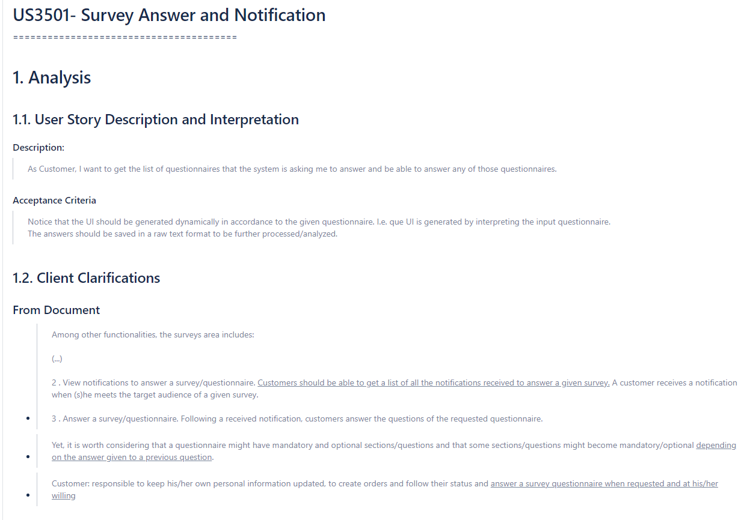
Analysis
s
Specification Document
MarkDown Documents

Slide 10
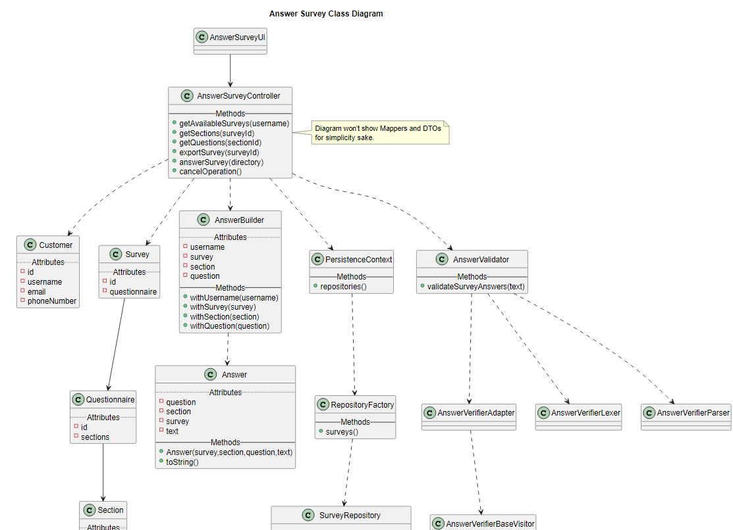
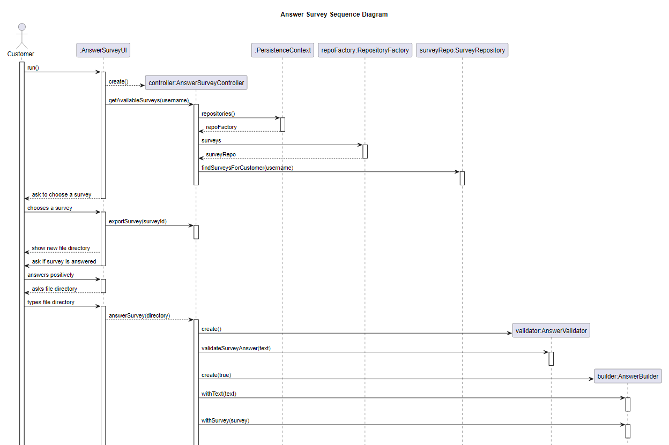
Design
s
Class Diagram
Sequence Diagram

Slide 11
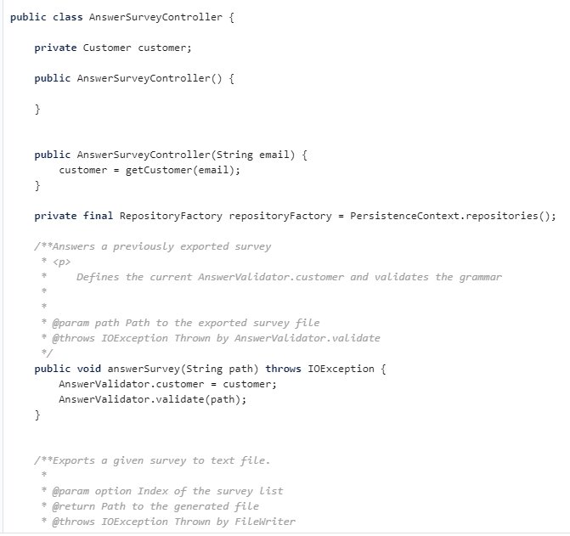
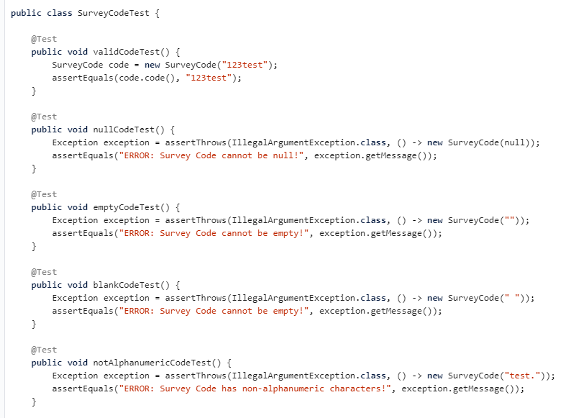
Implementation
s
Code
Unit Tests

Slide 12
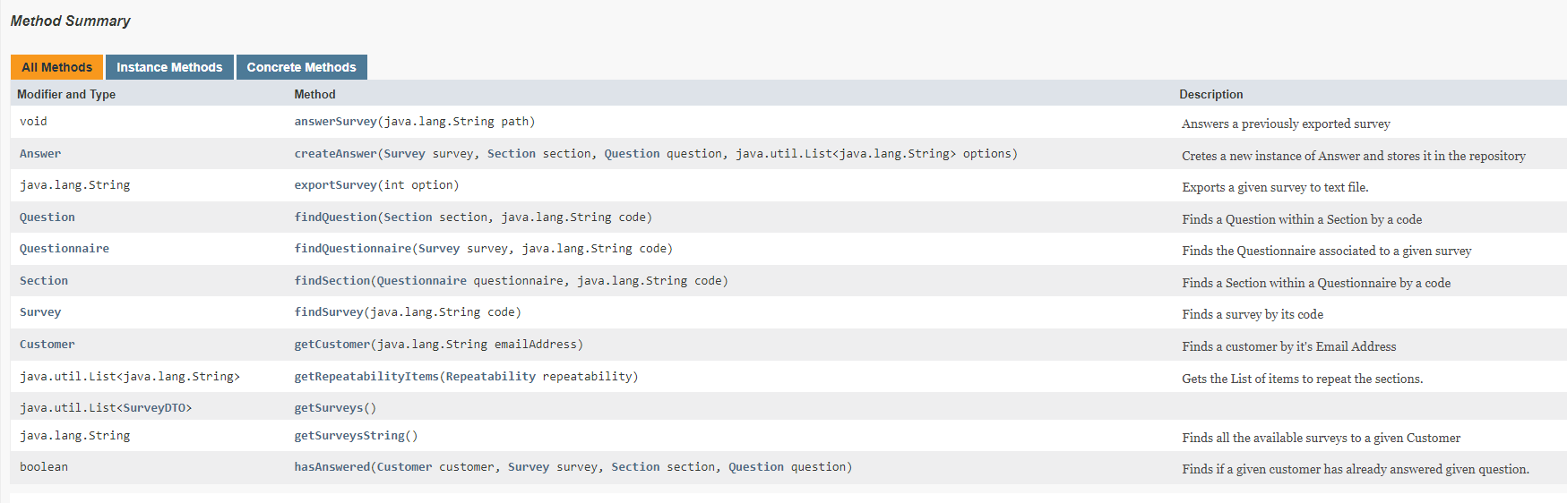
Review
s
JavaDoc

Slide 13
Possible Improvements

Slide 14
Improvements
Communications:
Increase availability
Stricter rules
Stricter mindset
Define goals
Development:
Define stricter formats
Define default strategies
Greater importance on maintenance
Share tasks often

Slide 15
Self-Assessment

Slide 16
Self-Assessment
Element | Evaluation (0-20)
(1190827) Luís Araújo | 18
(1201180) Guilherme Sencadas | 19
(1201216) Lucas Guimarães | 18
(1201217) Marco Ramos | 18
(1201228) Ana Silva | 18
Team | Evaluation
2DD_G03 | 18

